Slide 1

Cloud AI and Machine Learning
Group Members:
Caleb Watson-Danis
Catherine Daigle
Farhana Mahmud
Elias Ngugi Kariuki
Yue Gao

Slide 2
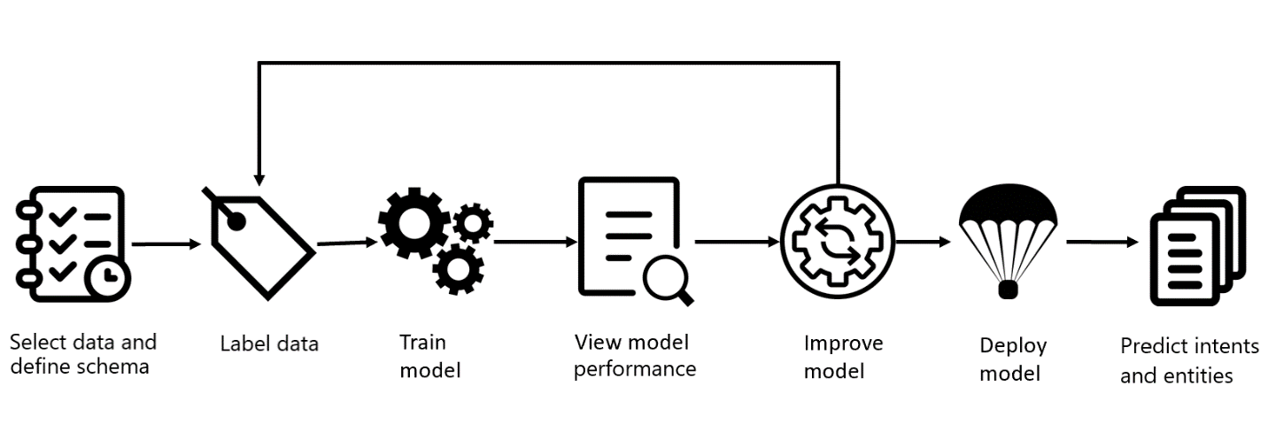
Introduction
What is AI and ML?
Use Case, Market Analysis, Challenges and Future of Cloud
Deploy ML in the Cloud following these steps:

Slide 3
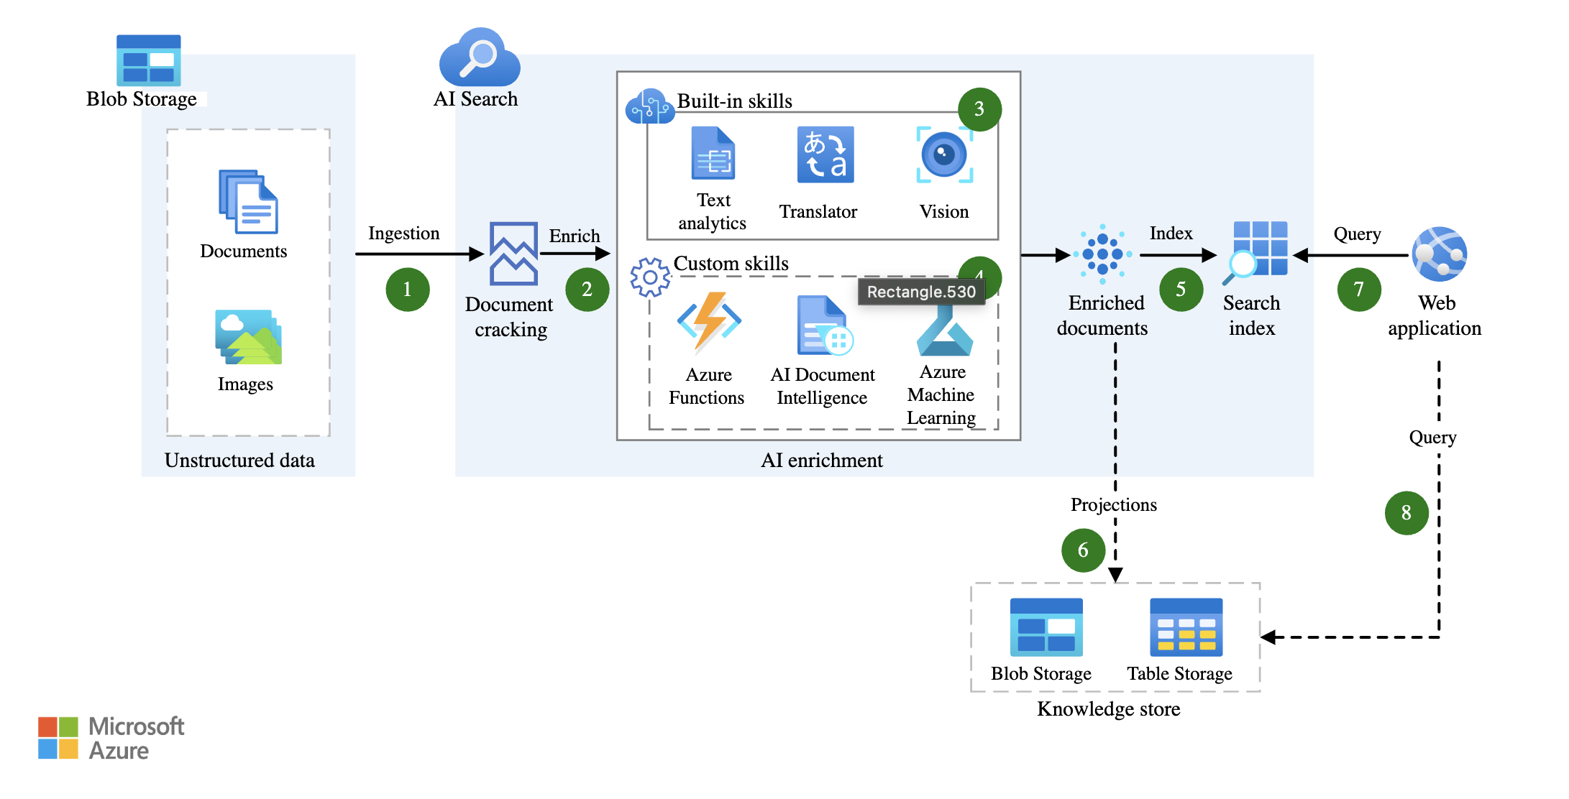
Chosen Cloud Architecture
How AI and ML Work together to create an Image and Text Processing Model

Slide 4




Use Cases
Cognitive Services
Bot Service
Custom Neural Voice
OpenAI Service
Machine Learning
Microsoft Power Platform

Slide 5
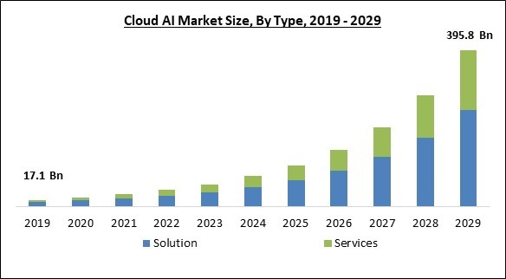
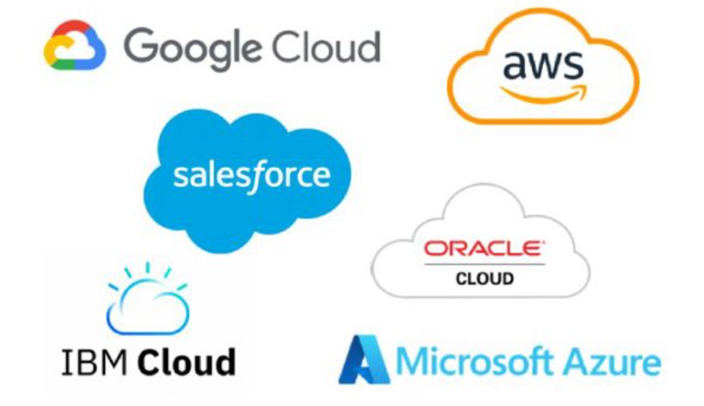
Market Analysis
Growth Forecast
Competitive landscape
Market growth 38.4% compound annual growth rate (CAGR) from 2023-2029

Slide 6
Key Challenges
Data integration
Scalability and resource management
Model training and deployment
Security and compliance

Slide 7
Proposed Next Steps
Future Improvements
Data Cleaning
Auto-scaling Infrastructure

Slide 8

What We Learned?
Gone through use cases of BBC, Shneider and Toyota
Observed AI and ML architecture
Observed the growth of Cloud AI market
Defined Challenges of Cloud and AI
Future of Cloud and AI

Slide 9
Short Quiz!
What is Machine learning?
Who are the key cloud AI providers?
How do you deploy a ML model?
What does CAGR stand for?
What is the difference between AI and ML?

Slide 10
Resources
Microsoft. (2024, August 28). What is conversational language understanding?. Azure AI Language documentation. https://learn.microsoft.com/pdf?url=https%3A%2F%2Flearn.microsoft.com%2Fen-us%2Fazure%2Fai-services%2Flanguage-service%2Ftoc.json
Research and Markets. (2023, April). Global cloud AI market size, Share & industry trends analysis report by type, by industry, by technology (solution deep learning, machine learning, Natural Language Processing), by regional outlook and forecast, 2023-2029. Research and Markets - Market Research Reports https://www.researchandmarkets.com/reports/5806529/global-cloud-ai-market-size-share-and-industry
Fitzpatrick. (2024, April 10). Cloud and AI — Who are the top 6 Cloud AI service providers?. Firebrand. https://firebrand.training/uk/blog/cloud-and-ai-who-are-the-top-6-cloud-ai-service-providers
Santos, C. A. (2023, August 21). Use AI enrichment with image and text processing. Artificial intelligence (AI) architecture design. https://learn.microsoft.com/pdf?url=https%3A%2F%2Flearn.microsoft.com%2Fen-us%2Fazure%2Farchitecture%2Fai-ml%2Ftoc.json
BBC innovates how it delivers trusted news and entertainment with Azure AI. (n.d.). Microsoft Customers Stories. https://customers.microsoft.com/en-us/story/754836-bbc-media-entertainment-azure
GeeksforGeeks. (2024, July 31). Data cleansing: Introduction. GeeksforGeeks. https://www.geeksforgeeks.org/data-cleansing-introduction/
Vates. (2024, July 11). The future of machine learning: Emerging trends and applications. Vates. https://www.vates.com/the-future-of-machine-learning-emerging-trends-and-applications/

